Slide 1
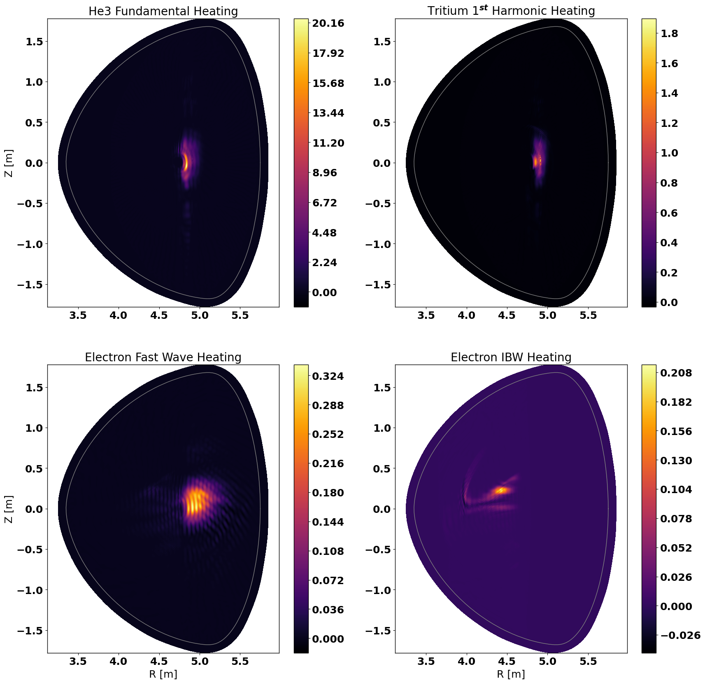
MW/m³
MW/m³
MW/m³
MW/m³

Slide 2
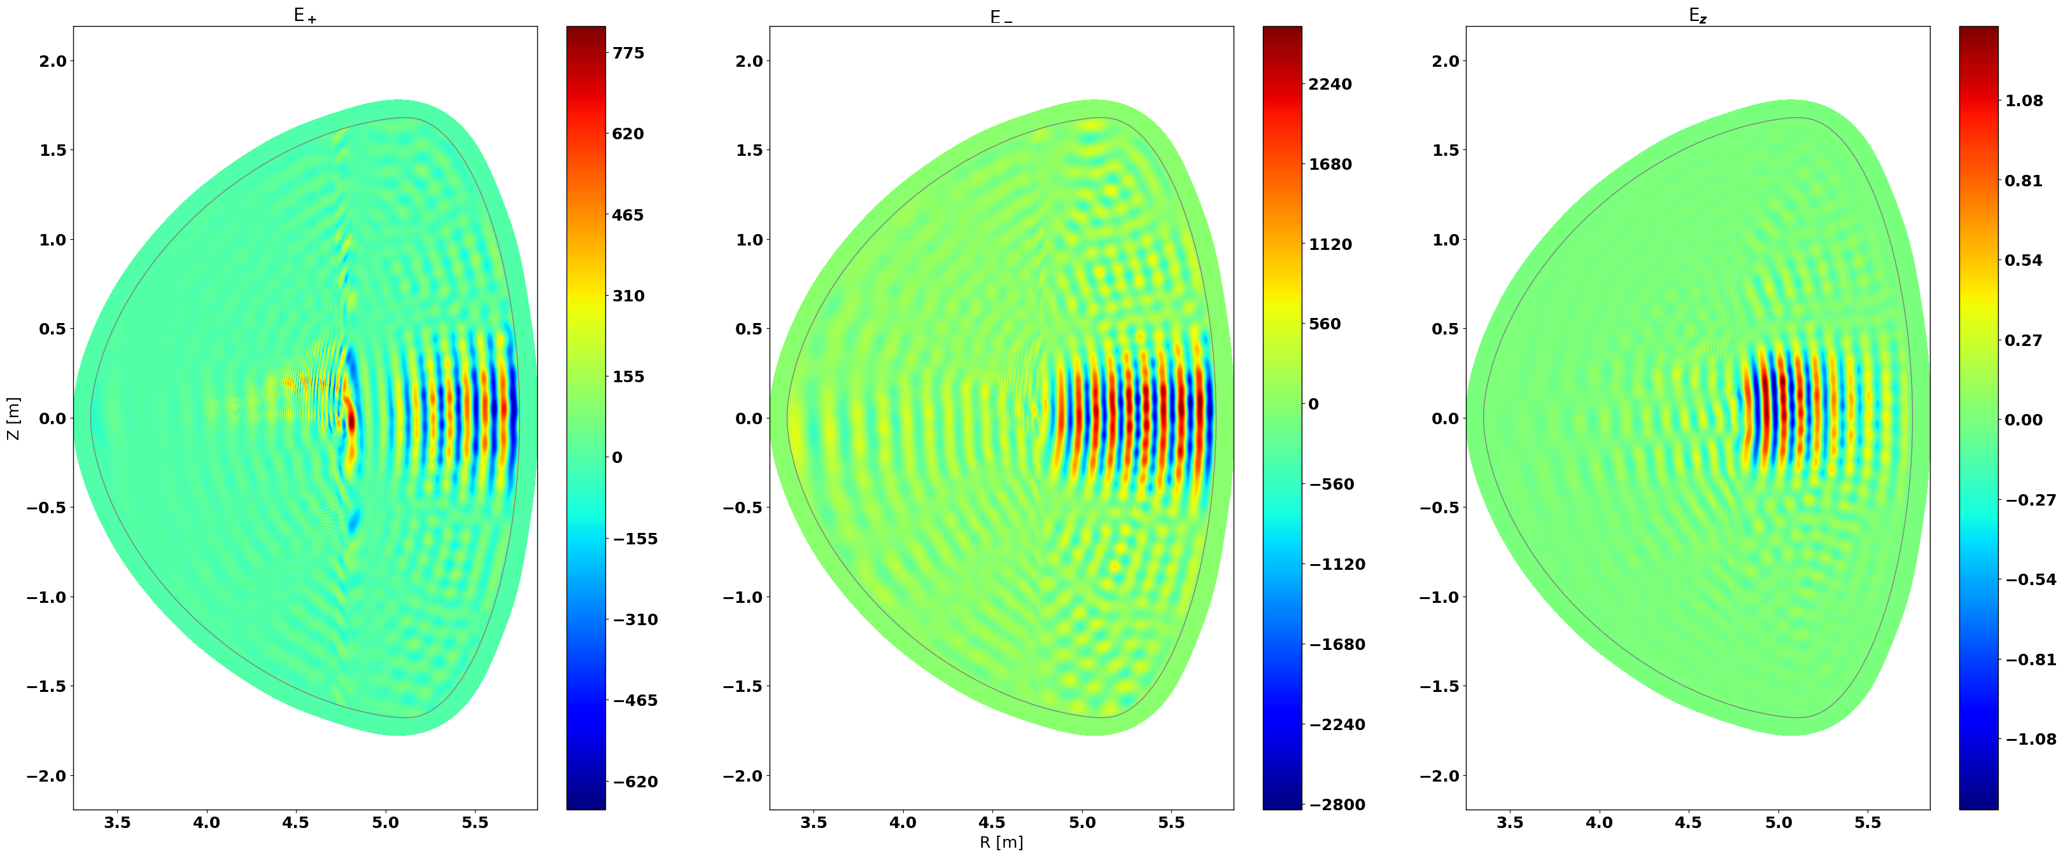
Arb. units
Arb. units
Arb. units

Slide 3
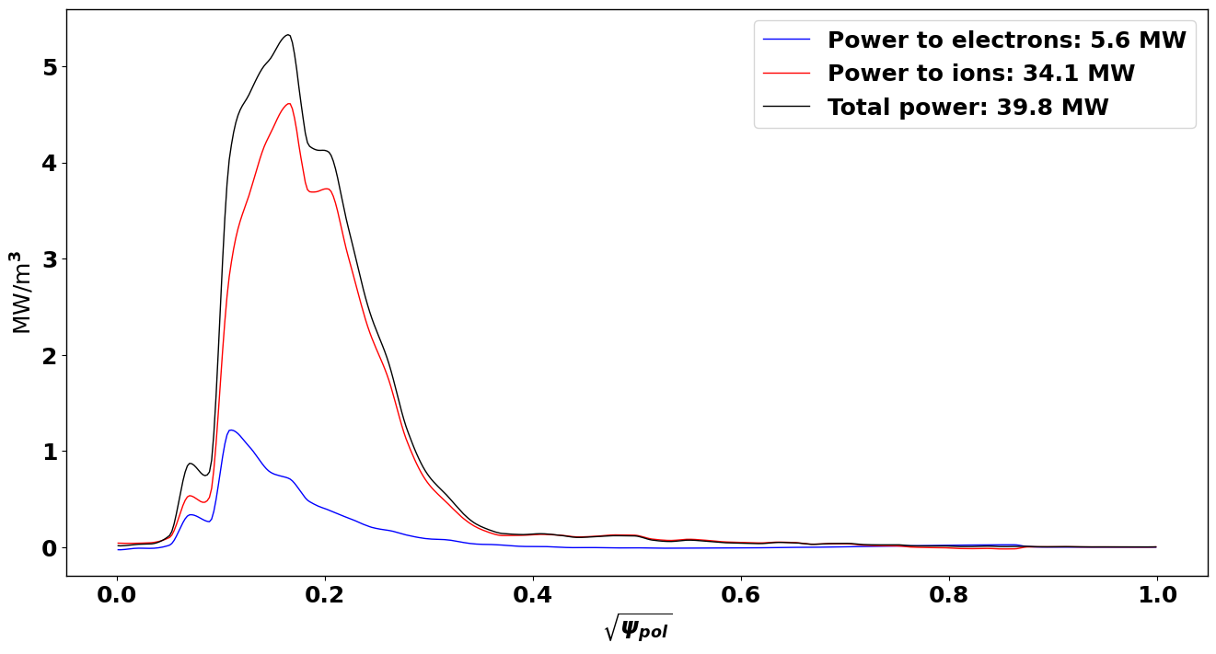

Slide 4
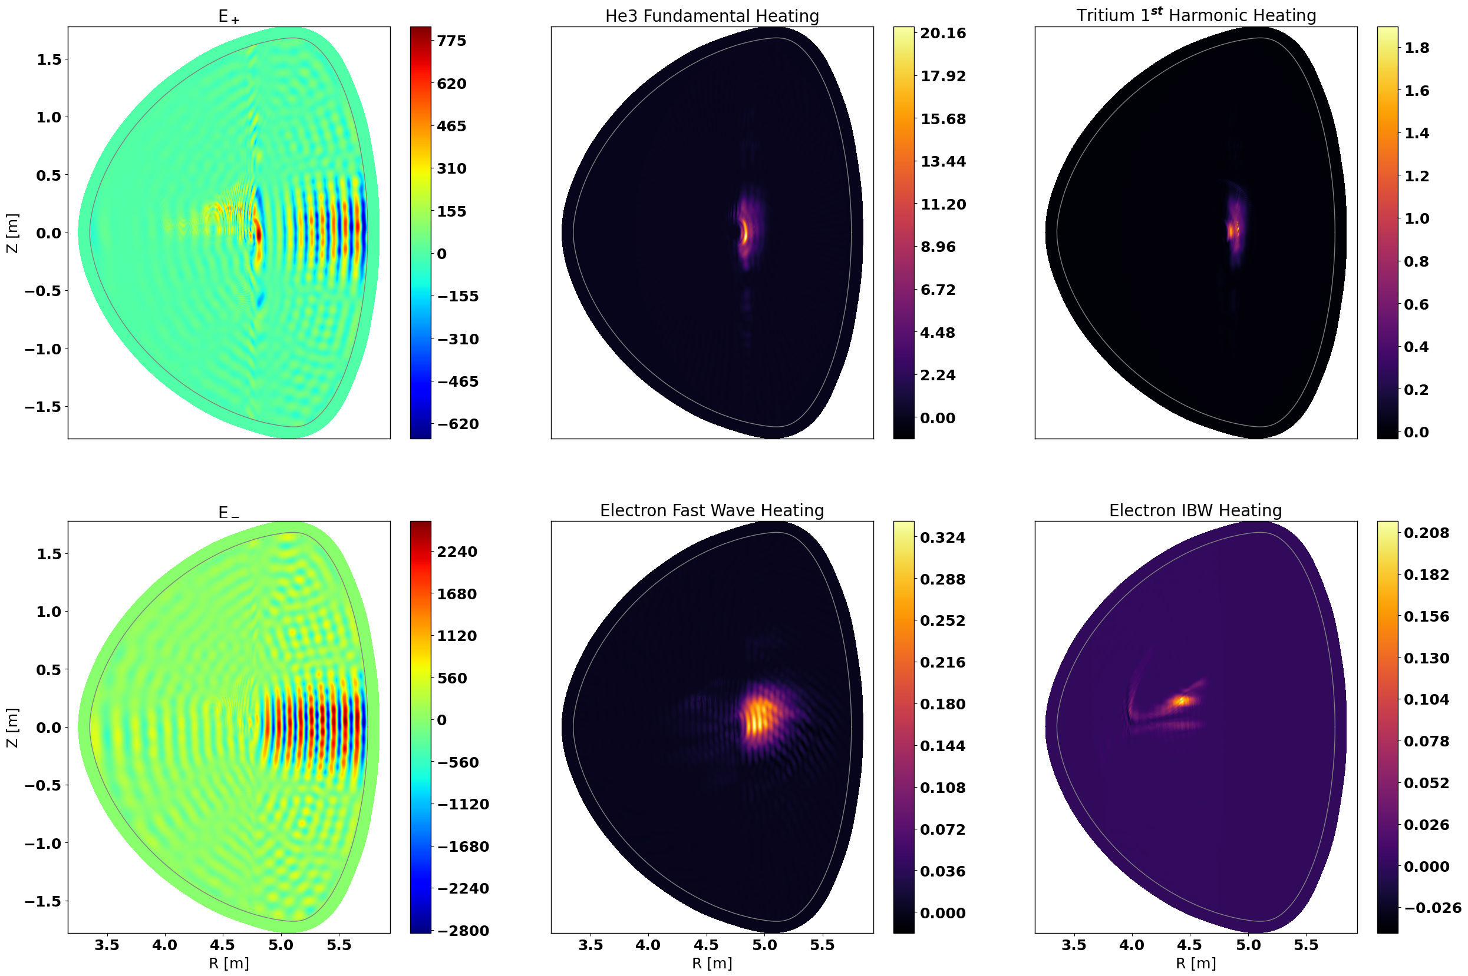
Arb. units
MW/m³
MW/m³
Arb. units
MW/m³
MW/m³

Slide 5
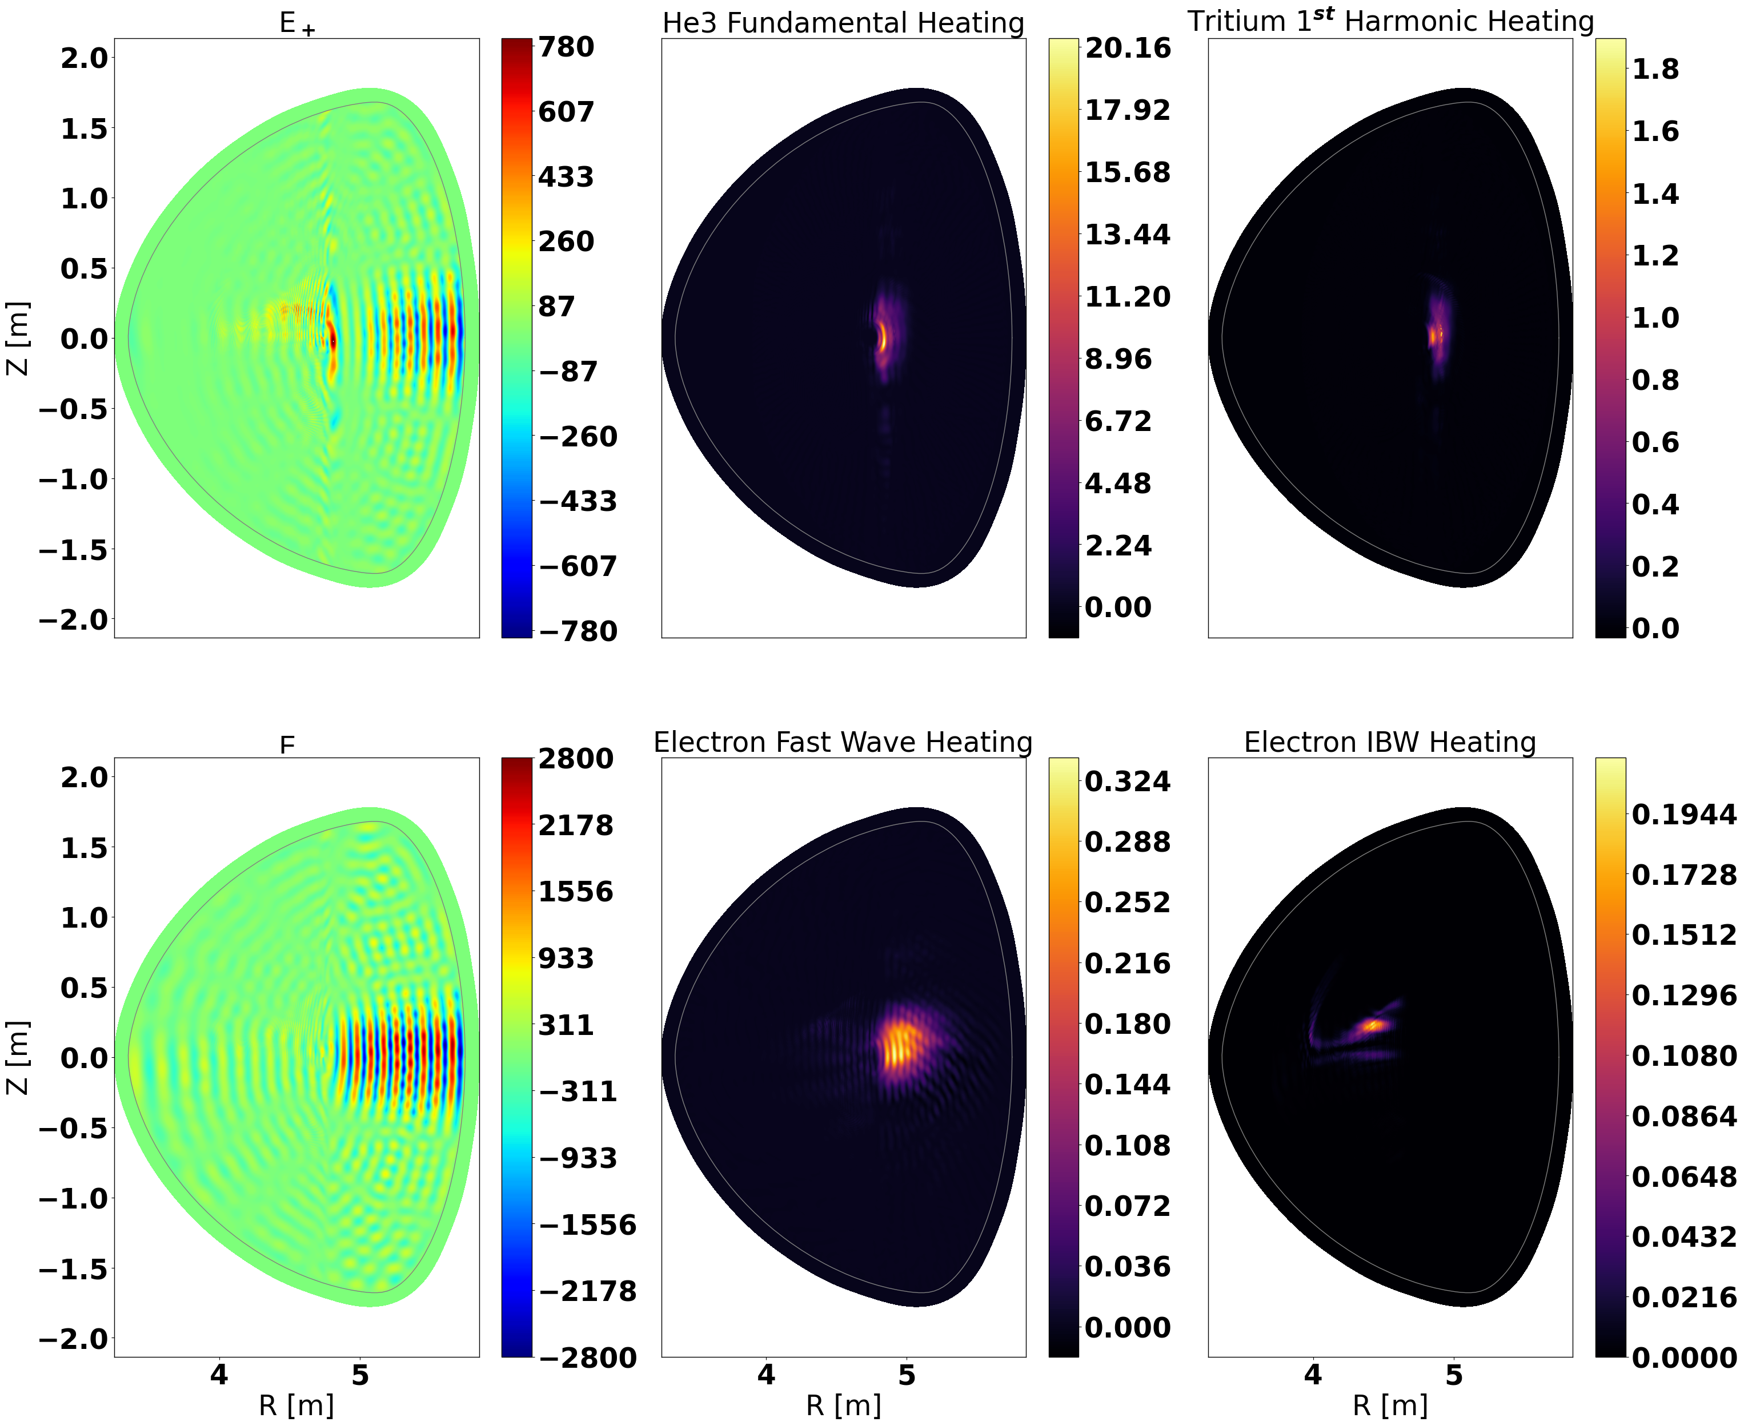
E₊
Arb. units
MW/m³
2nd
MW/m³
a)
b)
c)
Z [m]
E₋
Arb. units
MW/m³
MW/m³
d)
e)
f)
Z [m]
R [m]
R [m]
R [m]

Slide 6
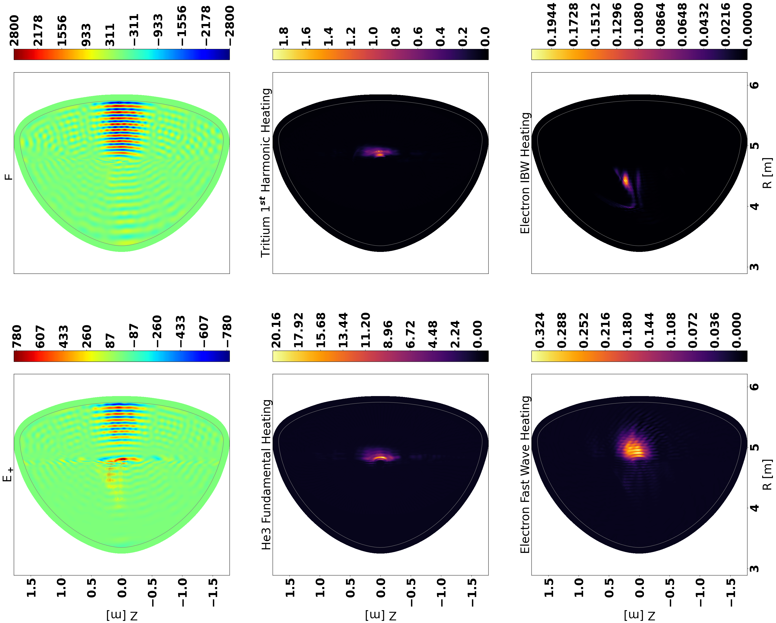
Arb. units
MW/m³
MW/m³
E₋
2nd
R [m]
b)
d)
f)
Arb. units
MW/m³
MW/m³
E₊
R [m]
a)
c)
e)
Z [m]
Z [m]
Z [m]

